Slide 1
Epidemiology &Study Desing in Medical Research
Akdeniz University Medical Faculty Department of Public Health

Slide 2
Steps in Public Health Action
Define the problem
Measure its magnitude
Understand the key points
Develop intervention and/or prevention
Set policy/priorities
Implement and evaluate

Slide 3
Epidemiology and Biostatistics
Epidemiology and Biostatistics are the basic sciences of public health.
Epidemiology is about to understanding of disease development and the methods used to uncover the etiology, progression and treatment of the disease.
Information (data) is collected to investigate a question.
Biostatistics is used to analyze the data to aid decision making.

Slide 4
Epidemiology and Biostatistics
Epidemiyology is the study of the distribution and determinants of health, disease or injury in human populations and the application of this study to the control of health.
Statistics is the science of dealing with variation of data in order to obtain reliable results and conclusions.
Biostatistics is the application of statistics to problems in the biological sciences, health and medicine.

Slide 5
Quantitative Methods &Public Health Paradigm
Steps in research process

Slide 6
1. Ask a public health question
Create a hypothesis
Based on scientific rationale
Based on observations or any evidence (Not scientifically tested before)
Based on results of prior studies
Example:
The use of a cell phone is associated with developing brain tumor.

Slide 7
2.Conduct a study
Survey Study is used to estimate the extent of the disease in the population
Surveillance Study is designed to monitor spesific diseases
Observational Studies investigate association between an exposure and a disease outcome. Indivudals take place naturally in exposed or non-exposed groups.
Experimental Studies also investigate the association between an exposure (often therapeutic treatment) and disease outcome. Individuals are «intentionally» placed into the experiment groups by the investigators.

Slide 8
3. Collect data
Numerical facts, measurements or observations collected from an investigation to answer a question
Example
The number of deaths from cardiovascular diseases in Turkish diabetics and non diabetics from 2010-2015.

Slide 9
4.Describe the observations/data
Use descriptive statistical methods to organize and summarize the data
Tables
Graphics
Summary measures (the mean, the median etc)

Slide 10
5.Evaluate the data
Statistical methods provide a confirmatory data analysis.
Generalize conclusions from data from part of a group (sample) to the whole group (population)
Assess the strength of the evidence
Make comparisons (use hypothesis tests)
Make predictions
Ask more questions for future research

Slide 11
6.Recommend interventions or preventive programs
The study results will prove or disprove the hypothesis or sometimes fall into a grey area of «unsure»
Depending on your conclusions; decide to offer a policy or an action ranging from developing specific regulatory programs to general personal behavioral changes

Slide 12
Example
Quantitative methods in public health

Slide 13
1. Ask a public health question Create a hypothesis
Hypothesis:
Seat belts save lives

Slide 14
2.Conduct a study
Study Design:
Observational cross-sectional study of fatality outcome and seat belt use of victims of motor vehicle accidents during one-month time period in Antalya City.

Slide 15
3. Collect data
Use the registrations
Find the data of motor vehicle accidents during one-month period
Collect the data of drivers of these vehicles (dead or alive, seat belt worn and not worn)

Slide 16
4.Describe the observations/data
Description: Effect of seat belt use on accident fatality
Seat belts appear(?) to save lives
 | Seat | Belt
Driver | Worn | Not worn
Dead | 10 | 20
Alive | 40 | 30
Total | 50 | 50
Fatality Rate | 10/50 (20%) | 20/50 (40%)

Slide 17
5.Evaluate the data
The inferential questions of interest are:
Are results applicable to the population of all drivers? (Generalization)
Does wearing seat belts save lives? (Assess strength of evidence)
Is the fatality rate of those not wearing seat belts higher than the fatality rate of those wearing seat belts? (Comparison using hypothesis tests)
How many lives can be saved by wearing seat belts? (Prediction)
Do other variables influence the conclusion like speed, alcohol use etc (Ask more questions)

Slide 18
5.Evaluate the data
Ask more questions: Does speed at impact influence the conclusion?
Using seat belts saved lives at high impact speeds but not at low impact speeds
Speed at impact
 | ≤ 30 miles per hour |  | > 30 miles per hour
 | Driver seat belt worn | Seat belt not worn | Driver seat belt worn | Seat belt not worn
Dead | 3 | 2 | 7 | 18
Alive | 27 | 18 | 13 | 12
Total | 30 | 20 | 20 | 30
Fatality rate | 10% | 10% | 35% | 60%

Slide 19
6.Recommend interventions or preventive programs
Spesific courses for schools
Mass media programmes
Penalties for drivers who dont wear seat belts
Suggestions for motor vehicle producers
Speed limitations etc.

Slide 20
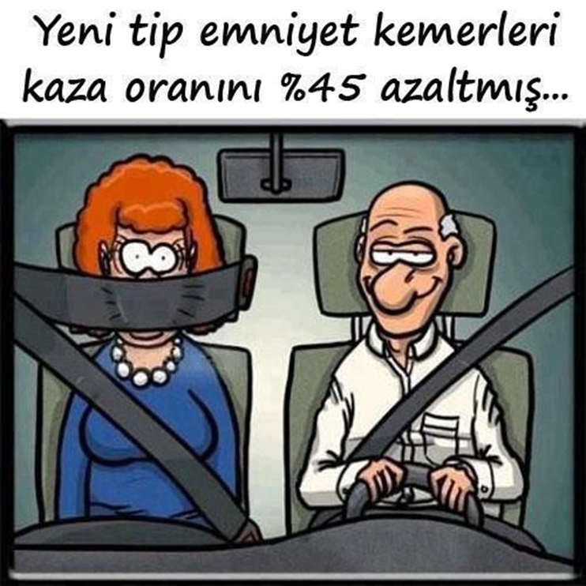
New style seat belts save lives

